Slide 1
VARIABLES
Storing and Manipulating Data
GD105 WEEK 2

Slide 2
agenda
take a look at the homework
review
variables
basic data types
naming conventions
basic operators
debugging
basic interaction
saving images

Slide 3
declaration;
ONCE
ONCE
LOOP
void setup() { our code goes here; //we comment here } void draw() { our code goes here; //we comment here }

Slide 4
void setup() { size(480, 120);
} void draw() { if (mousePressed) { fill(0); //fill(random(255),random(255),random(255)); } else { //fill(random(255),random(255),random(255)); fill(255); } //ellipse(mouseX, mouseY, 80, 80); }

Slide 5
Review:
What’s an IDE?
What’s a good analogy for code?
How does the coordinate system work?
What’s void setup() {...} ?
What’s void draw() {...} ?
Notes:
integrated development environment

Slide 6
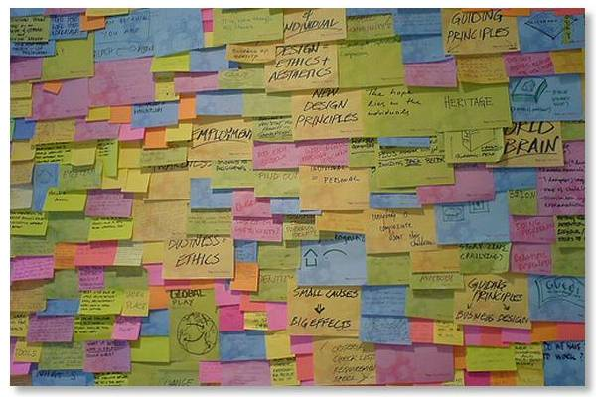
Variables
Notes:
post-it analogy
there’s a number of usual analogies, here’s the post-it one.
- there are different categories (colors)
- can name it whatever you want (name it something for your sake)
- can store information of the correct type

Slide 7
Variables
Think of variables as containers for holding pieces of information.
You need different containers for different types of information.

Slide 8
containers
Good for storing electronics… and other things too
Notes:
Content swappability

Slide 11
But not all containers are appropriate...

Slide 12
Variables
More technically:
“A variable is a named pointer to a location in the computer’s memory where data is stored. Since computers only process information one instruction at a time, a variable allows a programmer to save information from one point in the program and refer back to it at a later time.”
Notes:
post-it analogy
there’s a number of usual analogies, here’s the post-it one.
- there are different categories (colors)
- can name it whatever you want (name it something for your sake)
- can store information of the correct type

Slide 13
Variables
Two really useful features:
1. Data can be stored in a computer's memory so a program can access it and use it over and over.
2. Even better, a program can change this information while running.

Slide 14
Variables
What sort of things can you do?
Keep track of information related to shapes: color, size, location.

Slide 15
Data types
int
whole numbers
1, 2, -3, 40, 2013
float
floating point number (decimal points)
0.5, 1.34, 11.5, 7.0/2.0

Slide 16
Data types
String
ASCII characters, declared in quotation marks
"lemon", "meringue", "pie"
boolean
true, false
color
colors; by default uses RGB
(255, 177, 80)

Slide 17
Variables are declared and initialized(assigned).

Slide 18
Structure
Declarations
int x; //declare a variable for x
float y; //declare a variable for y
Notes:
"The first part of the code is going to contain variable declarations which you've already learned. As we go on, other things will appear here in the beginning such as the creation of objects and other pieces of code.
It is important to note that variables declared here are considered "global" variables, meaning they will be accessible to all of the code in the entire sketch. We will show examples of "local" variables later and how you might run into problems, but you should be putting all of your important variables here at the beginning"

Slide 19
Structure
Declarations
Initialization
(initial assignment)
int x; //declare a variable for x
float y; //declare a variable for y
void setup() {
size(500,500);
x = 0; //initialize x to 0
y = 5.3; //initialize y to 5.3
}
Notes:
"This part should look a little new. The first real part of the dynamic code structure is the setup. Everything between the two curly brackets will run only once at the very beginning of the sketch. This is where you will want to put things that set up your sketch such as size of the applet window, background color, loading images into the sketch (so that you aren’t loading images over and over, slowing down your program), etc.
MAKE REFERENCE TO THESE PIECES BEING MODULES/CHUNKS OF CODE
It is also good practice to "initialize" your variables here. This is actually loading values into your variables so that your sketch runs the way it needs to. Some variables might need to be initialized while others might not. It can be done in the initial declarations (for ex. "int x = 3;") but it is good practice to put them in the setup.
Note the syntax used: open and closed parentheses in addition to the curly brackets. If you have a foreign keyboard make sure you know how to use these.

Slide 20
Structure
Declarations
Setup
Draw
int x; //declare a variable for x
float y; //declare a variable for y
void setup() {
size(500,500);
x = 0; //initialize x to 0
y = 5.3; //initialize y to 5.3
}
void draw() {
ellipse(50, 200, x, x); //draw a circle
rect(100, 100, 30, 50); //draw a rectangle
}
Notes:
The Draw loop is where the meat of your sketch will go. Things between these curly brackets will run one line at a time from start to finish then loop back again to the beginning, running over and over again until the sketch is stopped.

Slide 21
Variables
int x = 0;
float var1 = 1.3;
boolean fred = true;
Notes:
These are examples of how to declare variables and initialize them in one shot. Note: when not specified, a boolean variable will default to false.

Slide 22
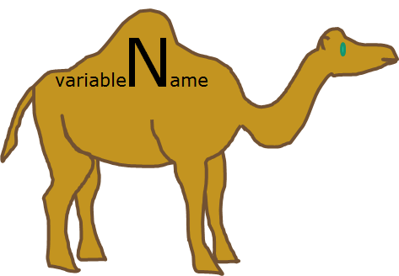
Naming Conventions
just use camelCase, actually. (but there are others)

Slide 23
Commenting Review
int variable2; //We can leave comments for ourselves
float readingValue; //Anything after the double slash is ignored
//by the compiler
/*
This type of comment also works. Everything between these two symbol pairs is ignored
*/
Notes:
use to -
- give yourself (and other people notes)
- “turn off” blocks of code during development / testing
i ALWAYS forget what stuff i made in old code means and it takes ages to figure it out again if i don’t leave detailed comments

Slide 24
ALL VARIABLES MUST HAVE...
A TYPE
why? - so the computer knows exactly how much memory should be allocated to store that variable’s data.
A NAME
why? - so the computer (and you) can make sense of everything.

Slide 25
VARIABLE NAMING TIPS:
- Avoid using words that appear elsewhere in Processing. (e.g. - don’t name a variable mouseX)
- Use names that mean something connected to what the variable is to be used for. (duh)
- Don’t start with capital letters! Use camelCase. (there’s a good reason for this but we’ll get there later)

Slide 26
Examples
int count = 0;
// Declare an int named count, assigned the value 0
char letter = 'a';
// Declare a char named letter, assigned the value 'a'
double i = 132.32;
// Declare a double named i, assigned the value 132.32
boolean happy = false;
// Declare a boolean named happy, assigned the value false
float x = 4.0;
// Declare a float named x, assigned the value 4.0
float y;
// Declare a float named y (no assignment)
y = x + 5.2;
// Assign the value of x plus 5.2 to the previously declared y
float z = x*y + 15.0;
// Declare a variable named z, assign it the value which is x times y plus 15.0.

Slide 27
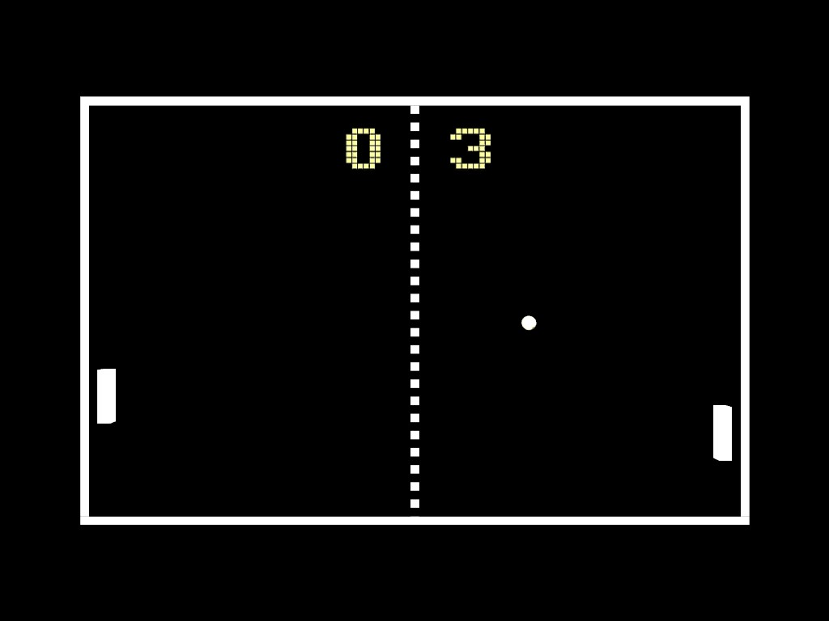
What sorts of variables could we use to have a functioning Pong game?

Slide 28
player 1 x position
player 1 y position
player 2 x position
player 2 y position
player 1 score
player 2 score
ball x position
ball y position
ball direction
etc.

Slide 30
Looking back at our material from last week:
Let’s use variables in place of our previously hard-coded values.
Notes:
colors, floats and ints for shapes
make them global variables.
“hard-coded” - fixed data or parameters in a program in such a way that they cannot be altered without modifying the program.

Slide 31
TRY NOW:
- using ints or floats to set positions
- use the “color” datatype to save colors
- use an int to set individual RGB components that color
organize and name things in a way that makes sense to you.
Notes:
do some demonstration here

Slide 32
There are also in-built System Variables for us to make use of
width
height
displayWidth
displayHeight
mouseX
mouseY
frameCount
Notes:
first use special variables to set some basics.
make a shape follow the mouse.

Slide 33
Try using system variables to set your object’s parameters
e.g. width, height, displayWidth, etc.

Slide 34
Last week we made some basic shapes. Now we’re going to use operations to do some basic interaction explorations.

Slide 35
Operators for simple math
An operator is a symbol that represents an operation.
The basics:
+ - * / =
This may be new to you:
%
Notes:
use operators to increment variables in the draw loop.
make some crazy procedural animations with shapes.
shape that changes over time, makes a drawing (see old jul19 sketches)

Slide 36
int a = 5 % 4; // Sets 'a' to 1 int b = 125 % 100; // Sets 'b' to 25 float c = 285.5 % 140.0; // Sets 'c' to 5.5 float d = 30.0 % 33.0; // Sets 'd' to 30.0

Slide 37
What happens if you try to add a float and an int together?
Give it a try now, then we’ll figure out what’s happening.

Slide 38
Debugging
println();
print();
Use to track your variables and give yourself other messages during runtime.
Use it to see if things are going to plan, or help find out where things are going awry!
Notes:
track one of the incrementing variables, maybe to see one that has moved offscreen?
increment a variable in setup to see why it isn’t working?
then move it into the draw loop.
also use a string to write out some labeled data.

Slide 39
Try doing some basic operations and printing the result.

Slide 40
Now take your variables and use them in basic operations instead
Try making:
- A counter that counts up every frame, like framecount
- An “xPos” variable that moves your object across the screen
- A color changer variable that changes the color of an object over time

Slide 41
Map Function - extremely useful
Re-maps a number from one range to another.
For example:
float myColorRange = map(mouseX, 0, width, 0, 255);

Slide 42
DON’T WORRY ABOUT THIS RIGHT NOW- WE’LL PUT IT IN ANYWAY
//inside draw loop
if (keyPressed) {
if (key == 's') {
saveFrame();
}
}
simple way for us to save screenshots of our fancy pretty fancy work.
pretty straightforward - this will make more sense later if it doesn’t now.
ps. try mousePressed
Notes:
use this to save a pretty picture of your work!!

Slide 43
Homework: CODING SCENARIO 2
CREATE A MOVING IMAGE!
Parameterize your previous HW to make it interactive and/or animated
Use variables (int, float, etc.) and operators (+, -, *, etc.) to change the sketch in some way over time
Try using system variables too (frameCount, millis(), etc.)
Try to experiment and don’t overplan the result - instead let things happen naturally with exploration and screenshot something that you think is cool!
Notes:
if they’ve already done a lot of this stuff, have them research and try using rotation on their own. show sketch 3 for an example of things they could try to do.

Slide 44
extra areas to explore, if you want -
rotation
iteration
recursion

